Slide 1
Is it a word or a sentence? How would we tell? What counts as evidence? Critical distinctions for quality assurance of clinical terminologies
Alan Rector BioHealth Informatics Group University of Manchester rector@cs.manchester.ac.uk
http://www.cs.manchester.ac.uk/~rector
Copyright University of Manchester 2012 Licensed under Creative Commons Attribution Non-commercial Licence v3

Slide 2
“Terminologies/ontologies”: What are they for?
To use in information systems
To support each system’s functionality
To support interoperability amongst systems
To communicate with people
Amongst people
Between informaiton systems and people
For use in:
Individual patient care
Population research, management, and public health

Slide 3
About this talk
What I have been doing recently – my motivations
Factoring the problem:
What’s a terminology? An ontology? A Thesaurus? A Knowledge base?
Common misconceptions about OWL/Description logic
Axioms vs Templates
How to QA SNOMED CT – or any similar ontology
One part of an answer – see also papers/presentations on website; http://www.cs.man.ac.uk/~rector
Issues arising in reconciling SNOMED and ICD 11
What’s in a code? A word? A phrase?
What counts as evidence?
Conclusion

Slide 4
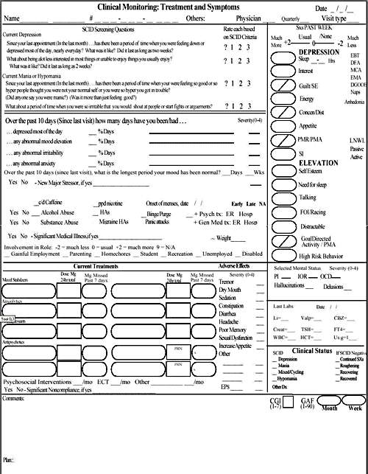
Problems I am trying to solve
How to generate complex forms for patient situations with multiple diseases and considerations
“An elderly man with confusion, rapid breathing, and extensive bruising as seen by the Emergency room Medic”
Pneumonia v alcohol v liver disease v head injury v diabetic coma…
Probably more than one
Without combinatorial explosion & assuring correctness
A typical hospital has several thousand forms many of which take over a person-year to develop; A typical patient may need several.
… and they don’t begin to cover what’s needed – THE bottleneck
To make things easier for clinicians & safer for patients
Too many
Too big
Too complicated & repetitive

Slide 5
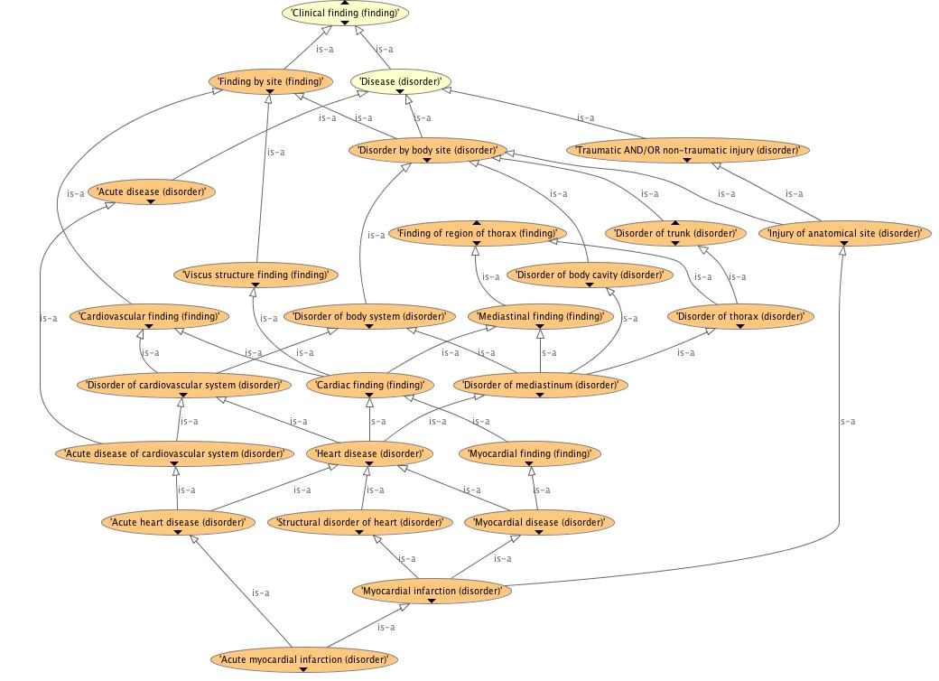
Problems I am trying to solve (II) How to tell if SNOMED is safe to use (or any other big terminology – 50K..500K classes )
Is it correct clinically? Formally?
Will “users” understand it sufficiently to use it correctly?
End users? Knowledge & software engineer users?
(See JAMIA, J Biomed Informatics, & KCAP papers on my website http://cs.man.ac.uk/~rector)
Why wasn’t Myocardial Infarction a kind of Ischemic Heart Disease?
Why wasn’t Subdural hematoma a kind of Intracranial bleed?
Why wasn’t Chronic duodenal ulcer a kind of Chronic disease?
Why was Thrombophlebitis of breast a kind of Disorder of leg? Why was Thrombosis of ankle vein a Disorder of pelvis?

Slide 6
Problems I am trying to solve (III)
How to reconcile ICD’s traditional classification and legacy with new requirements
Retain stability with previous versions
A classification – not an ontology
Fixed depth; mutually exclusive and exhaustive at every level
Every patient event counted exactly once at every granularity
Overcome major problems
Shorten 20-year revision cycle & support Social Computing approaches
Support multiple views & new requirements
Establish a common “core ontology” with SNOMED CT
Multi-layered structure
Ontology layer – hopefully reconciled with SNOMED
Foundation layer – lots more around the “skeleton” of the ontology
“Linearizations” – traditional classifications linked to Foundation layer

Slide 7
What is a “Terminology” for purposes of Health Informatics? Words + Entities + IDs
Linguistic resources (lexicons, grammars, synonyms, acronyms, …)
+
Conceptual / Logical / navigational resources (ontologies, classification systems, knowledge organisation systems, etc.)
+
Persistant, well managed IDs
…for SNOMED, NCIT, GO, … : Terms (Lexicon) + Concepts (Ontology) + IDs

Slide 8
What is an ontology? Historical defintions…
Ontology_{Philosophy}
The study of “being” – of “What there is”
The study of “universals” – “What is necessarily true”
As opposed to: “Particulars” – What happens to be true in this world/time-place
… but not all of the study of knowledge, nor the only useful way of organising things
Ontology_{Information systems}
Gruber’s fancy word to describe “static knowledge base”
Gave it a fancy definition: “A conceptualisation of a domain”
Others have broadened meaning until meaningless
A fancy word for a common terminology used in a set of data structures and/or applications
What we can implement in OWL

Slide 9
“Ontology_{InformationSystems}” Narrow definition:
The definitions and necessarily true statements about the concepts represented in a system, e.g.
“A pneumonia is any inflammation of the lungs with consolidation”
“The heart is part of the circulatory system”
“Pneumococcus is a kind of bacterium”
Organised logically hierarchies such that:
All instances of a child are instances of its parent
Everything true of a parent is true of all its children
Everything that satisfies a concept’s definition is one of its descendants
Without exception
Notes:
References:
¹ See Herb Simon and Allen Newell. Numerous publications. Most accessible is probably Simon’s Sciences of the Artificial.
See also
Newell, Allen; Simon, H. A. (1976), Computer Science as Empirical Inquiry: Symbols and Search, "Communications of the ACM", Communications of the ACM 19 (3): 113–126, doi:10.1145/360018.360022

Slide 10
Formally: (for those interested in the logic)
That part of knowledge representation that can be expressed as positive universal statements in logic: ∀x . C(x) … ←→ … ∀x . C(x) … → …
Often presented as hierarchies of entities: “Cs are kinds of Ds” ≡ “All Cs are Ds” ≡ “∀x . C(x) → D(x)”
One important subset: what can be expressed in Description logics (DLs) / OWL
Computationally tractable subsets of first order logic

Slide 11
… What do we mean by “ontology_{NarrowSense}”? * One part of study of knowledge * One part of knowledge representation * The source of the entities/terminology
Philosophy of Knowledge
Particulars
Particulars
Particulars
Ontology_{Philosophy}
(Universals)
Pathways/ workflows
Probablities / Bayes networks
Probablities / Bayes networks
Probablities / Bayes networks
Protocols
Knowledge Representation
Data structures
Heuristics
possibilities
Rules
Facts
associations
Thesauri
Lexicons
Schemas
Classifica-tions
Ontology_{InformationSystems}
(definitions & necessarily true statements)

Slide 12
Distinguish from other useful but different artefacts…
Classifications & Groupings (ICD, DRGs, …)
Counting – every case counted exactly once at every level
Thesauri, Library coding (MeSH), SKOS networks (also MindMaps, ...)
Navigation by people - intuitive connections
“broader than”/ “narrower than”
Lexicons, & other Linguistic resources
Language processing (WordNet, UMLS SN, etc.)
Data schemas, structures & databases (UML, etc.)
Information on particulars and how to store it
Other logico/mathematical models
Bayesian networks, neural networks, equation systems, rules, decision trees, pathways, …

Slide 13
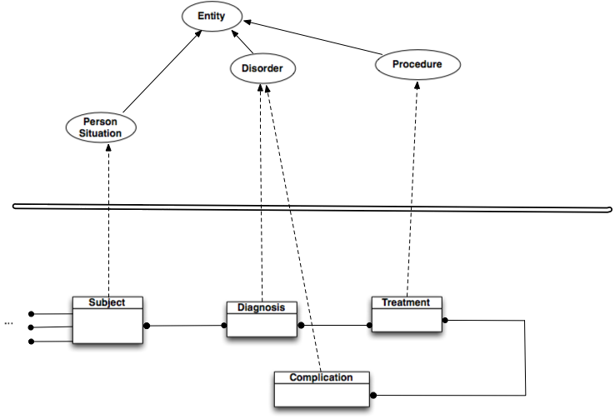
Most common use case:
Ontology
Data schema

Slide 14
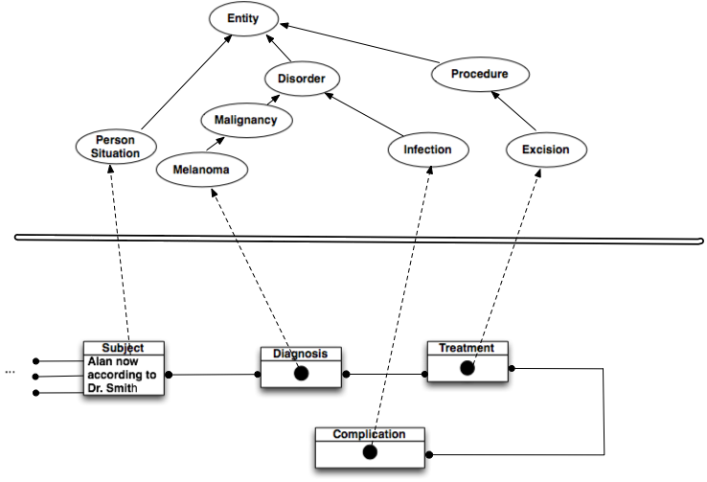
Most common use case:
Ontology
Data structure

Slide 15
Why I use OWL/DLs for Ontologies / Terminologies
Composition / Coordination “Burn that has_site some (Foot that has_laterality some Left) & has_penetration some Full_thickness & has_extent …& … & … & …”
Avoid combinatorial explosion –
Smaller terminologies that say more
Support for expressions as well as names (“post-coordination”)
Express context
The “weight of elephants” vs the “weight of mice” “heavy elephant” vs “heavy mouse”
Coordinate hierarchies and index information, e.g. hierarchies for:
“Cancer”,”Family history of cancer”, “Treatment of cancer”, “Risk of cancer”, “Data structure for cancer”, “Data entry form for cancer”, “Rules for Cancer”, …
How else to get it correct?
Quality assurance & explicit meaning
Computational tractability
A standard
Notes:
8K-35K kinds of burns, depending on number of dimensions and number of levels in each

Slide 16
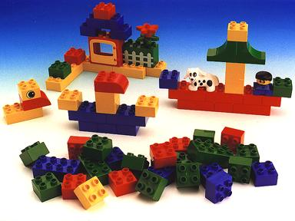
Ontologies: Logic as the clips for “Conceptual Lego”
gene
hand
protein
extremity
polysacharide
body
cell
expression
chronic
Lung
acute
infection
abnormal
inflammation
normal
bacterium
deletion
polymorphism
ischaemic
virus
mucus

Slide 17
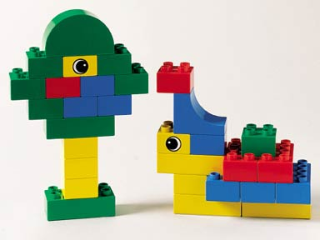
Logic as the clips for “Conceptual Lego”
“SNPolymorphism of CFTRGene causing Defect in MembraneTransport of
Chloride Ion causing Increase in Viscosity of Mucus in CysticFibrosis…”
“Hand which is anatomically normal”

Slide 18
Composition: Building with “Conceptual Lego” Parallel families of hierarchies
Species
Genes
Protein
Function
CFTRGene in humans
Disease
Protein coded by (CFTRgene & in humans)
Membrane transport mediated by (Protein coded by (CFTRgene in humans))
Disease caused by (abnormality in (Membrane transport mediated by (Protein coded by (CTFR gene & in humans))))

Slide 19
The exploding bicycle (thanks to Jeremy Rogers)
1972 ICD-9 (E826) 8
READ-2 (T30..) 81
READ-3 87
1999 ICD-10 CMA……

Slide 20
1999 ICD10 CMA: 587 codes
V31.22 Occupant of three-wheeled motor vehicle injured in collision with pedal cycle, person on outside of vehicle, nontraffic accident, while working for income
W65.40 Drowning and submersion while in bath-tub, street and highway, while engaged in sports activity
X35.44 Victim of volcanic eruption, street and highway, while resting, sleeping, eating or engaging in other vital activities

Slide 21
I use OWL/DLs for many things, but…
Not everything written in OWL/DLs is an ontology
Not every ontology need be, or can be, written in OWL
OWL is a logic language – a subset of First order Logic
Designed to make it easy to represent (aspects of) ontologies, but
Can be used for other things.
Has many limitations
Has many serious flaws
But it is a standard and computationally tractable
Usually worth using a standard where you can

Slide 22
Before going further:
Brief history of ontologies in information systems, Description logics, OWL
Some common confusions & misconceptions

Slide 23
Early Knowledge representation
Mid 1980s, AI toolkits (KEE, ART, KnowledgeCraft…)
Tripartite “Knowledge based systems”
Static knowledge base – Semantic Networks expressed as frames
Included both “universal” and “particular” knowledge
Rules
Dynamic knowledge base
Plus Metadata, attached procedures, event driven UIs, …
Addressed good questions in knowledge representation, and gave some good answers, even if sometimes limited
Heuristic
Programming languages rather than logics

Slide 24
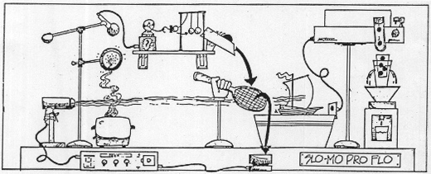
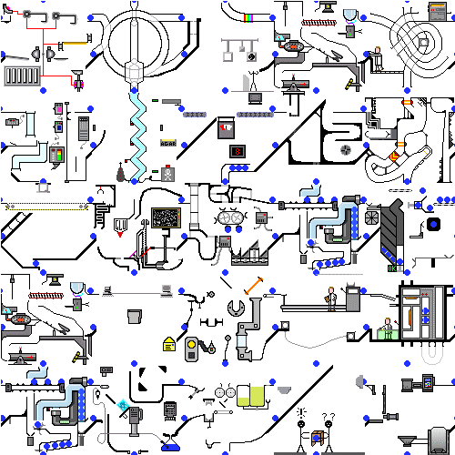
… some systems resembled Rube Goldberg machines
Neither complete, decidable nor provably sound
But good enough that still asked: “Why can’t we get back to 1985?”
Serious question from Zak Kohane, top HI researcher, PhD in AI from MIT.

Slide 25
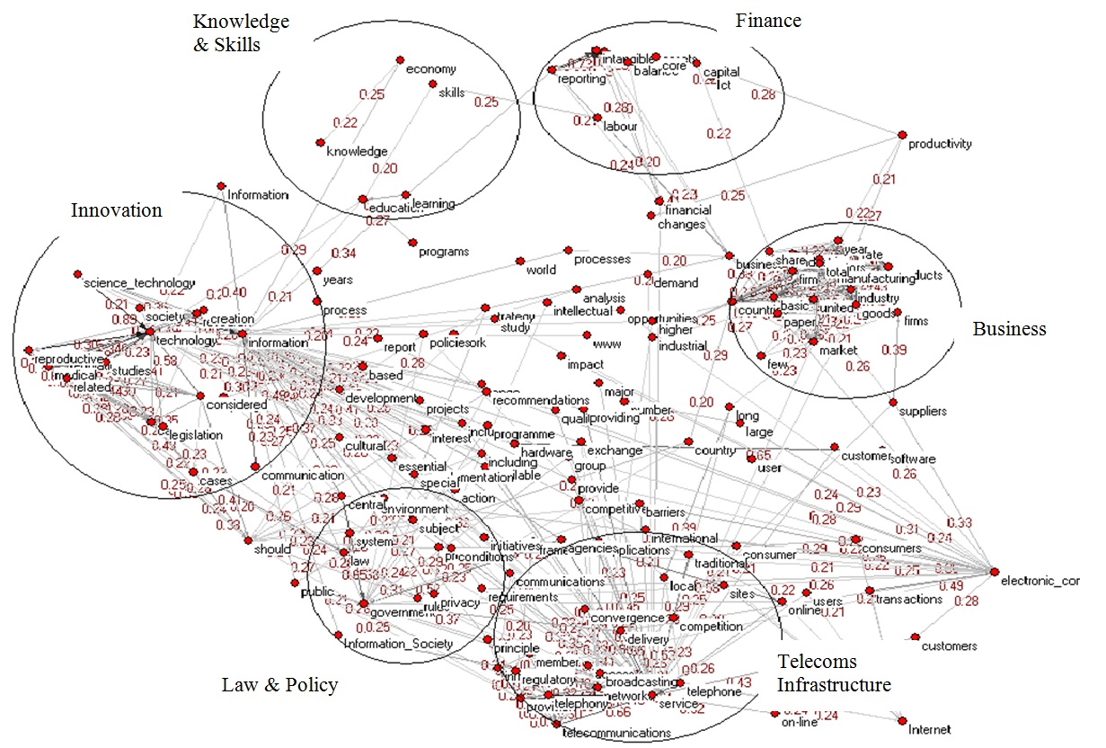
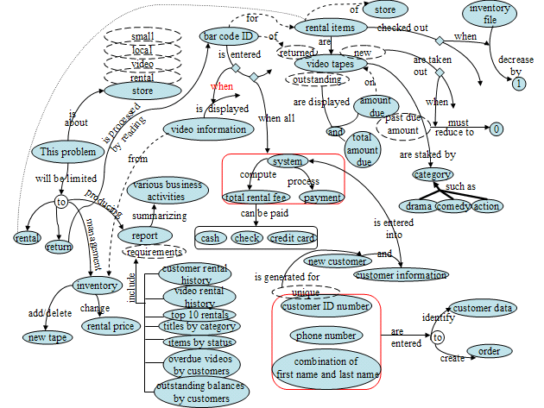
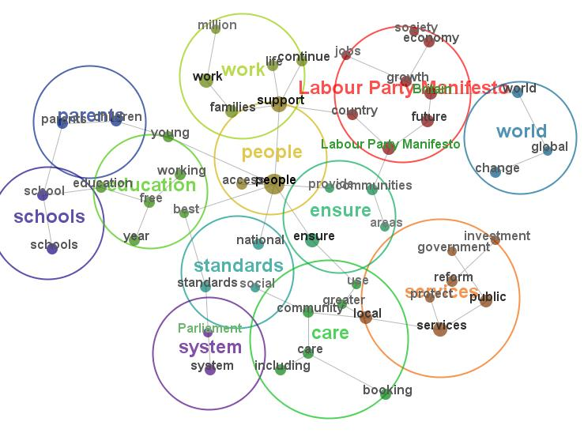
Knowledge Based Systems co-evolved with semantic networks & frames
“Frame” coined by Minsky for computer vision but rapidly adopted by knowledge representation
Convenient way to represent Object-Attribute-Value triples & semantic networks
Protégé-frames / OKBS is modern descendant

Slide 26
But then…Logicians asked ‘What’s it mean?’
Questions about Semantic Networks and Frames
Wood: What’s in a Link; Brachman What IS-A is and IS-A isn’t.
First Formalisation (1980)
Bobrow KRL,
Cognitive Science Vol 1 Issue 1 Page 1
Brachman: KL-ONE
Went on to be the ancestor of DLs
…of rather its failure stimulated the development of DLs
All useful systems are intractable (1983)
Brachman & Levesque: A fundamental tradeoff (AAAI 1983)
Hybrid systems: T-Box and A-Box
Focus on Terminology (T-Box) – Universal knowledge
Became what we now call “Ontology_{InformationSystems}”
All tractable systems are useless (1987-1990)
Doyl and Patil: Two dogmas of Knowledge Representation AI vol 48 pp 261-297 (1991)

Slide 27
Emergence of DLs and “Tbox” reasoning
‘Maverick’ incomplete but tractable in practice TBox/logic systems (1985-90)
GRAIL, Krep (SNOMED), LOOM, Cyc,…,
The German School: Description Logics (1988-98)
Complete decidable algorithms using tableaux methods (1991-1992)
Detailed catalogue of complexity of family – “alphabet soup” of logics
Horrocks (& Nowlan): practically tractable even if worst case intractable
FaCT⁺⁺ (1997-2000)
Emergence of the Semantic Web & OWL (2000-2003)
Development of DAML (frames), OIL (DLs) → DAML+OIL → OWL→ OWL2
Emergence of more tractable Subsets of DLs/OWL– EL⁺⁺, Conjunctive queries, … (2005..current)
Roughly what GRAIL and SNOMED had been doing but logically proven
ELK, SNOROCKET, …

Slide 28
…but Description logics are very different from frames (even though intended to formalise them)
Frames are systems of Templates Description logics/OWL are sets of Axioms
Failures to realise the difference leeds to confusion
Most SW Engineering paradigms use templates
OO Programming (e.g. Java objects)
UML Class diagrams, Model Driven Architectures (MDA/OMG)
Many general knowledge representations use templates
Frames (Protégé frames)
Cannonical Graphs in Sowa’s Conceptual Graphs
RDF(S) (as usually used)
F-Logic, …
Protocols, guidelines, …

Slide 29
Templates & Axioms: Fundamentally different
Templates permit
The more you know the more you can say
If there is no field/slot in the template you just can’t say it
Local – changes affect only a class & its descendants
Closed world - Instance validation natural & local
Violations of templates → validation errors (found immediately)
Over-riding / exceptions are natural (usually non-monotonic)
One step development – most consequences immediately visible
Axioms restrict
The more you know the less you can say
If there are no axioms, you can say anything
Global – any change can affect anything anywhere
Open world
Violations of axioms → unintended inferences (not found until classification)
Over-riding / exceptions impossible - monotonic
Two step development – Consequences may not be obvious
Stated form → <inference engine> → inferred form Distribution form

Slide 30
Potential mismatch
SNOMED is formulated in a description logic
Axiom system
HL7, CEN 13606, Archetypes, … are formulated as data structures;
Template systems
Beware of confusion
Adapt Quality Assurance methodology to Axiom systems

Slide 31
How to QA SNOMED: An experiment of opportunity
The opportunities
Tried to use SNOMED for Commercial Collaboration on Clinical Systems
Tried to use SNOMED as contribution to WHO’s revsion of International Classification of Diseases (ICD-11)
Problems with both
Therefore, experiment if QA & repair were possible
Conventional wisdom said that it was not
However, we had new resources
Core Problem List Subset from NLM (8500 most used classes)
Software to extract “modules”
SNOROCKET Classifier for EL++
4-8GB machines

Slide 32
What to QA? “Stated form” vs “Distribution form”
Analogy with debugging programs
Stated form ~ Source files
Classifier / Reasoner ~ Compiler
Distributed form / ~ Object code / hierarchies applications
By analogy
Find errors in distributed form (hierarchies & applications)
Pinpoint source of errors and correct them in stated form
After changes, reclassify and check distributed form again
Fixing one bug may add another
Fixing the bug without tracing it its source is likely to make a mess

Slide 33
How do we know if it is correct?
If I ask questions, do I get the correct answers?
Responses to queries & consequences for decision support rules
As judged by domain experts
As tested by empirical studies
As tested by results in applications
Some errors are obvious in applications
Omissions:
Myocardial infarction should be kind of Ischemic heart disease
Queries for Ischemic Heart disease are expected to return Myocardial Infarctions
Rules for Ischemic Heart Disease should apply to Myocardial infarctions
Definition: “Infarction” ≡ “Cell death due to ischemia”
Omitted in prior versions of SNOMED
Commissions
Injuries to arteries of the ankle are not disorders of the pelvis
Schema error in previous versions of SNOMED
Thrombophlebitis of breast is not a disorder of the lower extremity
Simple accident in anatomy compounded by same schema error in SNOMED

Slide 34
Step 1: Cut SNOMED down & find a classifier
Find a subset
E.g. UMLS Core Problem List subset -
8500 most used disease concepts
Collected by US National Library of Medicine by combining sets from 6 major institutions.
Extract a “Logically complete Module” (extractor built into OWL API v3)
Use core subset as “signature”
Guarantees that all inferences amongst the classes in “signature” in whole will hold in module
35,000 concepts - including most of anatomy
Find a classifier that can cope - at least two for checking
SNOROCKET or ELK (EL++) SNOMED’s subset of OWL (30 sec)
Pellet 2.1 (200 sec)
FaCT++ (250 sec)

Slide 35
Step 2: Pick some areas of interest to clinicians: some with anomalies already spotted
Myocardial Infarction (Heart attack)
Should be a kind of Ischemic Heart Disease, but wasn’t
Hypertension (High blood pressure)
Odd to find it a kind of Soft Tissue disorder
Diabetes mellitus
Odd to find it as a Disorder of the Abdomen
Allergies
Odd to find some but not all autoimmune disorders classified as Allergies.
…

Slide 36
Look at classification: Most initial errors spotted looking upwards
Look up hierarchy (with OWLViz)
Let clinicians find important concepts and check them
Face validity and then look up the hierarchy
(Check any anomalies against the complete SNOMED in standard browser
Guard against artifacts in various transformations)
Trace anomalies to their root in stated form (source files)
Decide which links to add or break
Decide how to break them
Edit, classify and check
Hierarchies
Usages

Slide 37
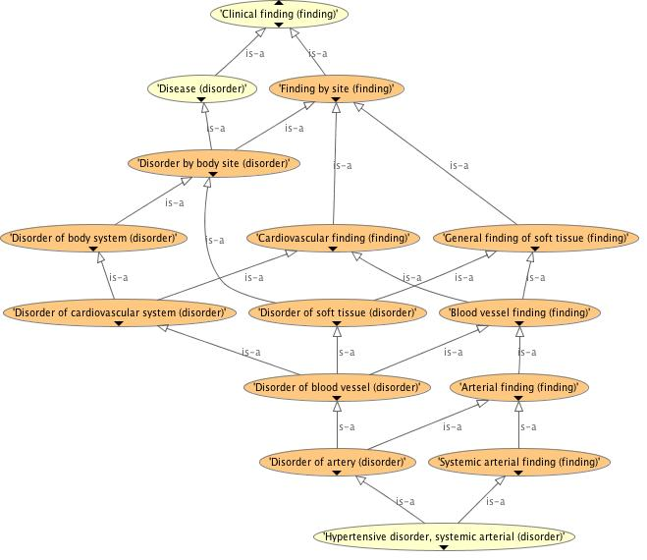
OwlViz Upwards for Hypertension

Slide 38
Examine definition & formulate solution
Disorder of blood vessel that
(Finding site some Systemic arterial structure) and (Has definitional manifestation some Increased blood pressure))
Disorder of blood vessel that
(Finding site some Cardiovascular system structure) and (Has definitional manifestation some Increased blood pressure)

Slide 39
And check for the desired result

Slide 40
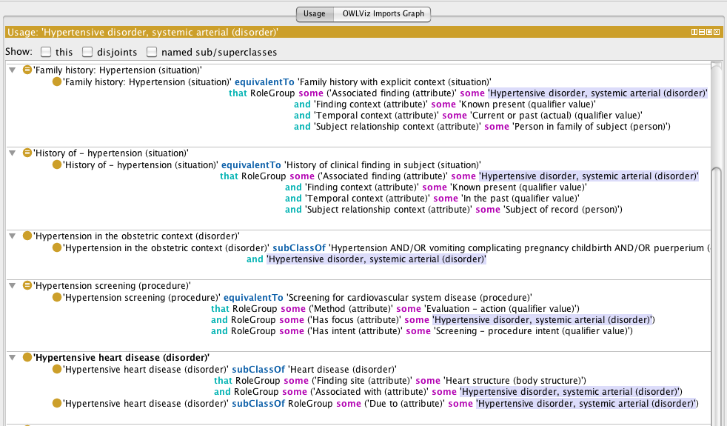
Then check usages for unwanted results - anything that should relate to arteries instead of Cardiovascular system?

Slide 41
Also look down hierarchy: Combine lexical & semantic search
Hard to spot what is missing
Hypertensive disorders included some complications as well as kinds of hypertension. Did it contain them all?
Use scripting language (OPPL) to combine lexical, owl queries & closed world meta-queries
?C:CLASS=MATCH(“.*[Hh]ypertensive.*”) ← lexical SELECT ?C SubClassOf ‘Disease (disorder)’ ← open world OWL semantics WHERE FAIL ?C SubClassOf “Hypertensive disorder” ← closed world meta-query BEGIN ADD ?C SubClassOf Odd END; ← action
Classify and look at Odd cases
…

Slide 42
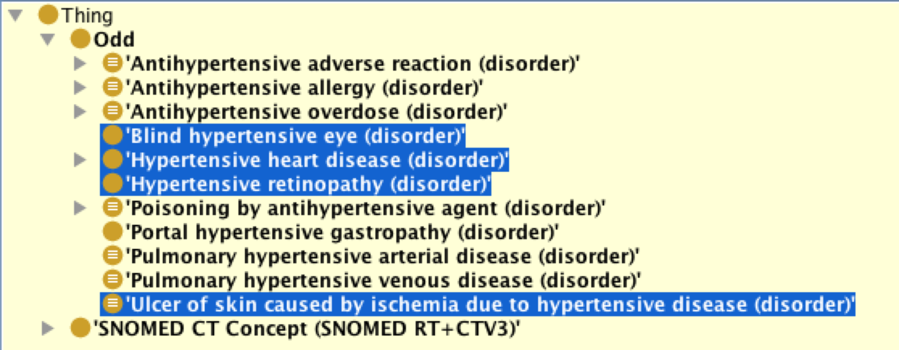
Classify and look at odd cases
Examine, fix, reclassify & check

Slide 43
Look for regularities
Of hypertensive complications
1 linked to Hypertensive disorder by property due to
1 linked to Hypertensive disorder by property associated with
2 are subclasses of Hypertensive disorder
2 not linked at all
No class for Hypertensive complication
Although there is a class for Diabetic complication
Regularise
Create classes for
Hypertension,
Hypertensive complication and
Hypertension AND/OR Hypertensive complication
Edit all complications to schema: Disorder due to some Hypertension

Slide 44
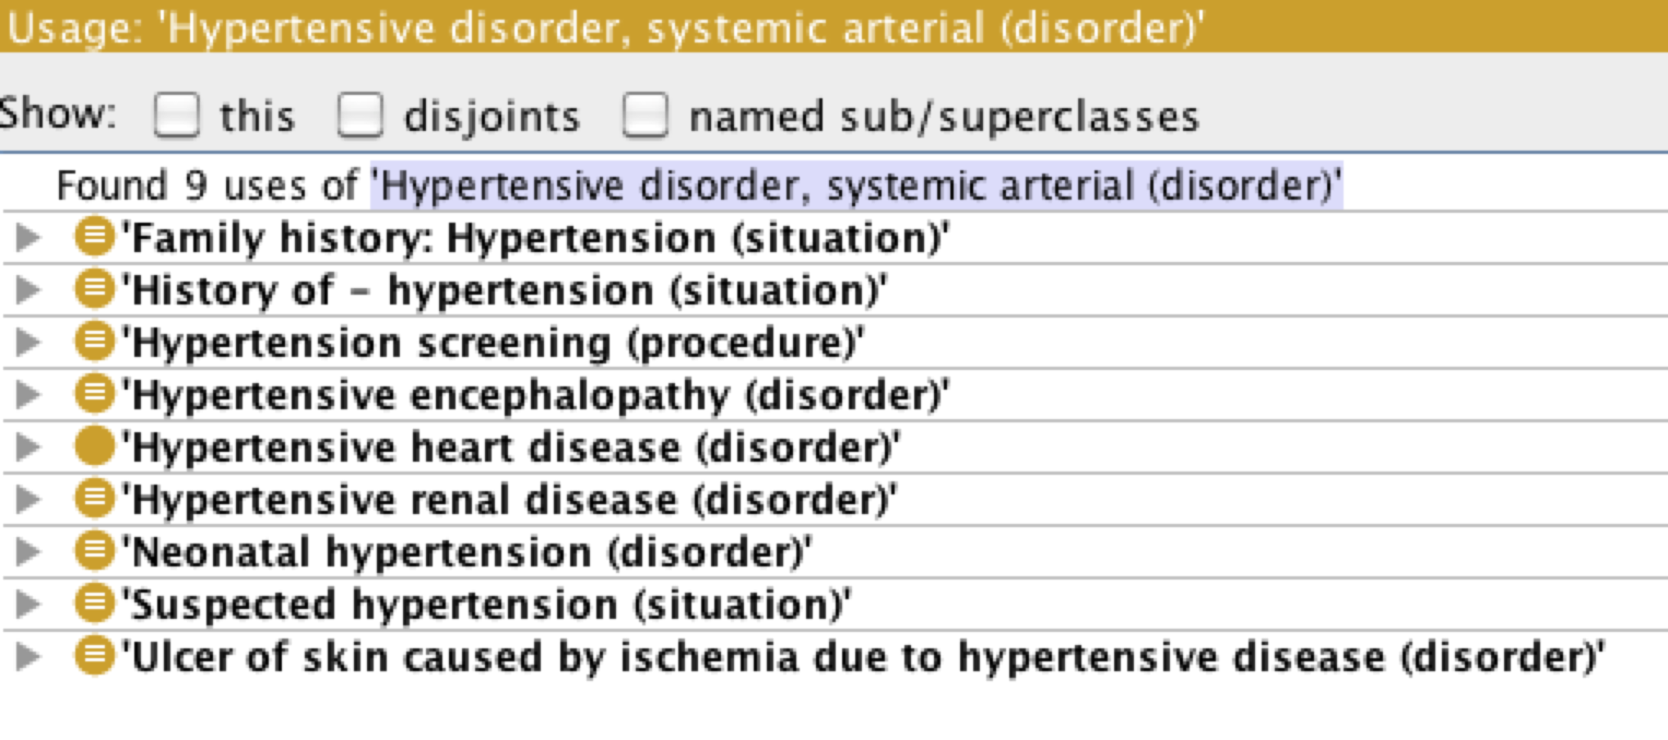
Which concept should carry the old ID?
Look at usages of Hypertensive disorder
All fit Hypertension; none fit Hypertensive complication
Therefore, label original ID for Hypertensive disorder as Hypertension
New Hierarchy:
Hypertension AND/OR Hypertensive complication ← new ID/concept Hypertension ← old ID/concept …kinds of hypertension Hypertensive complication… ← new ID/concept … kinds of hypertensive complication

Slide 45
Always trace errors to root to fix Otherwise get “helter-skelter modelling”
Simple error
The axiom that Skin is a kind of Soft tissue was omitted
Therefore Injuries to skin are not listed as kinds of Soft tissue injuries
Authors have noticed some cases and tried to compensate
Cut of skin of foot was a kind of soft tissue injury, but Cut of the skin of lower limb was NOT a soft tissue injury
One axiom to fix it all: Skin subClassOf SoftTissue:
And then a script to find the redundant axioms

Slide 46
… but sometimes it is hard to agree on what is the “right” answer Example from work on ICD11-SNOMED harmonization (Thanks to Stefan Schulz)
Should “Fracture of Radius & Ulna” be a kind of “Fracture of Radius”?
Should “Tetralogy of Fallot” be a kind of “Pulmonary stenosis”?
How do we find out?

Slide 47
“Condition” vs “Situation” “Word” vs “Sentence”
Does a code represent
A “disorder”?
“Condition” interpretation
“having a disorder”?
“Situation” interpretation
“Situation of having a disorder” /
“Patient having the disorder at a given place and time as observed by| a given clinician”

Slide 48
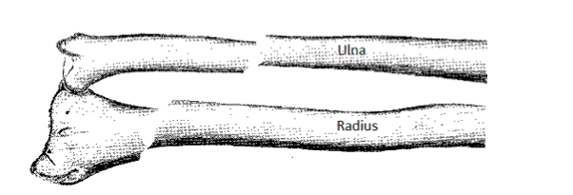
Example: Fracture of Radius & Ulna (Forearm) – a single code in ICD and SNOMED
“Condition interpretation”
Nothing can be both a “fracture of radius” and “fracture of ulna”
“Situation interpretation”
A patient can simultaneously have both a “fracture of radius” and “fracture of ulna”

Slide 49
The evidence
Should responses to queries /rules for patients with “Fracture of Radius” include patients with “Fracture of the radius & ulna”?
Most doctors say “yes”
Both SNOMED and ICD say “yes”, i.e. hierarchies classify:
“Fracture of Radius and Ulna” as a kind of “Fracture of Radius”
Which is safer?

Slide 50
What do we ask the questions for? What is the right answer for these purposes?
Deciding patients’ treatment
As antecedents of rules
Counting patients’ by causes of illness & death (morbity & mortality)
To contribute to vital statistics
Counting patient episodes for remuneration & Health Care Planning
To manage the healthcare system
Counting patient events for research into cause and effect
As nodes in a causal network
As part of the inclusion/excluson/outcome criteria for clinical studies

Slide 51
A further example
Should “Diabetic kidney disease” be classified under Diabetes? Kidney disease? Both? Neither?
Should queries for patients with “Diabetes” include those coded only for “Diabetic kidney disease”
Can anyone have “Diabetic kidney disease” without having “Diabetes”?
Many similar cases examined and experiments performed
Conclusion: “having a condition” (“Situation interpretation”)
Best fit for:
Current practice
Intended consequences
The reality of clinical practice
Safety in clinical decision support

Slide 52
… but: Issues for SNOMED
Options if this is correct
Create separate codes for “condition” and “situation”
Accept ambiguity of codes between “situation” and “condition”
Residual problem either way
Some “Situations with specific concepts” already exist
Unless major reorganisation Users still need to know that that they must always look in two places for patients with any given condition
Under the condition
Under the situations including that condition in certain (but not all contexts)
Is this reliable? Is it safe?
Current proposed solution
Accept ambiguity; train users always to formulate queries to look in two places – main hierarchy and Situations with specific context

Slide 53
Conundrum 2: What do biomedical experts mean by is_part_of?
In medicine, function is often more important than structure (except for surgeons & anatomists)
“A fault in the part is a fault in the whole” Conclusion or Criterion?
Is the radio part of the electrical system of my car?
Are T cells part of the immune system?
Is there any structure that can be called the “endocrine system”
Is the brain part of the skull? The pericardium part of the Heart?
Accidents & abnormalities often ignored
e.g. “Finger” defined as part of hand
Even if amputated, crushed, or congenitally missing
Even though rarely arises congenitally someplace else

Slide 54
What answers do we want to our questions
What are the parts of the hand?
What is in that path bottle that is/was “John’s finger”
What are the disorders of the hand
Fracture of finger? Amputation of Finger? Missing finger?
Mitochondrial disease (that includes mitochondria in cells of the hand)?
Is pericarditis a heart disease?
Clinically yes, contrary to FMA
Is a brain disease a disease of the skull?
Clinically no, consistent with FMA
A real problem for Foundational Model of Anatomy
If used “as is” gives some answers inappropriate clinically
Even when ontologically and anatomically correct

Slide 55
Summary
The test of a terminology / ontology is the consequences for use
Populations, patient care, rules, retrieval
Quality assurance of SNOMED is possible
But its axiom-based representations (OWL, DLs) is different from template-based representations
Require special tools – modules, visualisation, scripting, …
Looking up the hierarchies is an effective way to spot oddities
QA can lead to surprising conclusions & change in schemas
“having a disorder” / “situations” for SNOMED
Quality Assurance of SNOMED is possible & URGENT! (at least of a critical subset)
Is it responsible to use a resource with major known errors?

Slide 56
END - Outcuts

